Slide 1
Doctor appointment booking system
Presented by : M Abdul Rafay ( FL23791 )
Nazish Khan ( FL23843 )
Ali Atif ( FL23824 )
Zohaib Ijaz ( FL23811 )

Slide 2
Agenda
Project Overview
Problem Statement
Goals and Objectives
Usability Issues in Existing Website
Usability Principles & Metrics
System Architecture and Principles
Conclusion

Slide 3
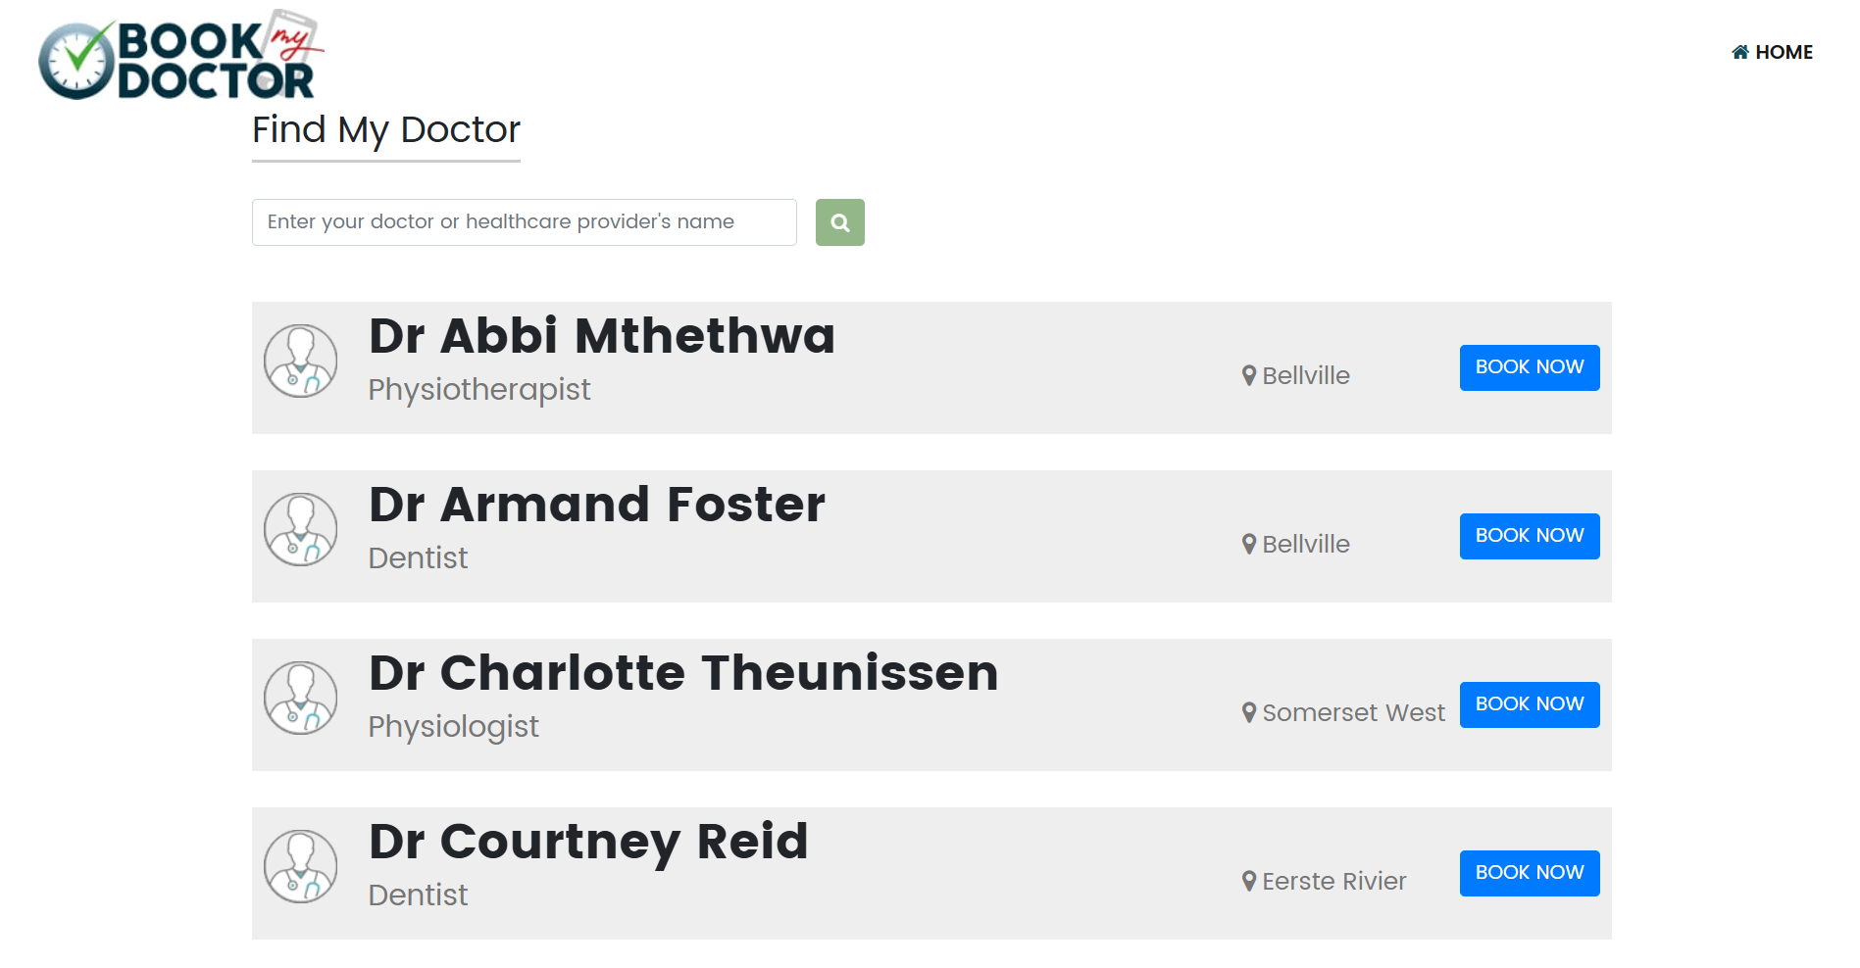
Project Overview
Domain: Healthcare Web Application
Project Type: Doctor Appointment Booking System
Focus Area: UI/UX Improvement & Usability
Existing Website Analyzed: bookmydoctor.co.za

Slide 4

Problem Statement​
Existing system is difficult to use
Confusing navigation
Poor visual design
No clear appointment booking flow
Low user satisfaction

Slide 5
Goals
Improve overall usability
Simplify doctor search and booking
Enhance user experience
Design a clean and modern UI
Build a complete working prototype

Slide 6
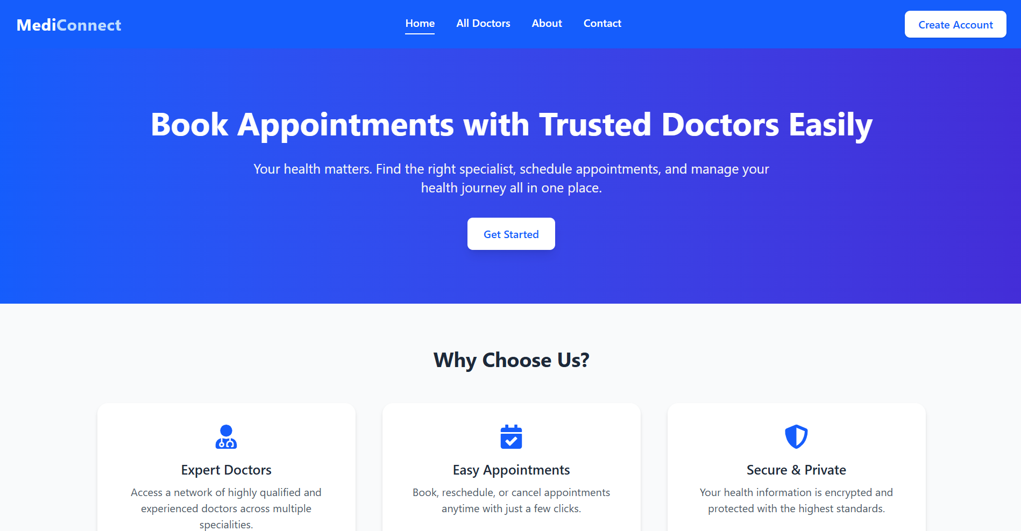
Improvements & Usability Metrics
Improvements
Clean and modern UI
Consistent colors & fonts
Clear call-to-action buttons
Metrics
Clicks reduced:
Booking time reduced
User satisfaction improved

Slide 7
System Architecture & Workflow
System Architecture
Design: Figma
Frontend: User Interface
Database: Appointment & User Data
Workflow
User searches doctor
Selects available slot
Books appointment
Confirmation generated

Slide 8
ConClusion
Identified major usability issues
Applied usability principles successfully
Developed a complete working prototype
System is ready for live demonstration

Slide 9
THANK YOU

